Slide 1
Painterly Rendering for Animation: A Maya Extension
David Dufresne
Matt Forni
B. Tyler Parker
CS224 class of 2010

Slide 2
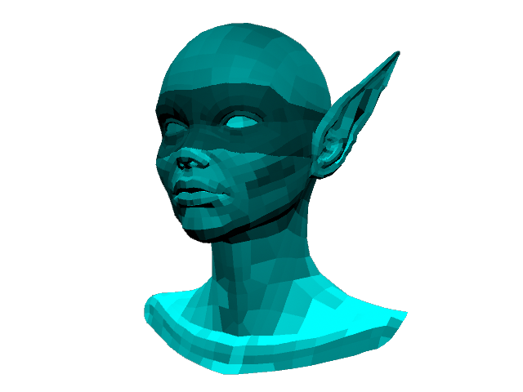
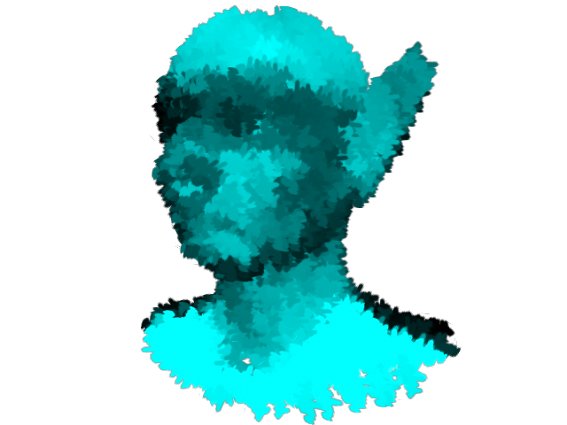
Painterly Rendering in a Nutshell
User provides 3D model(s) and painting parameters
Computer generates brush strokes based on the given parameters and the attributes of the 3D models in order to create a render that appears to have been hand painted

Slide 3
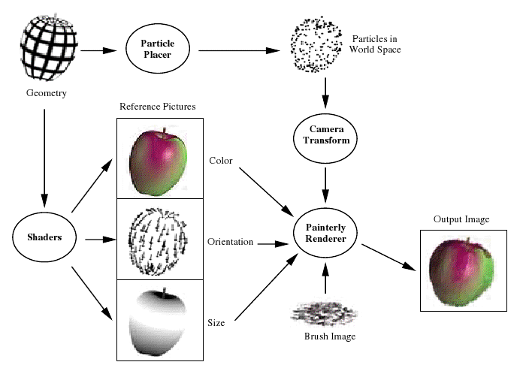
Barb’s Painterly Pipeline

Slide 4
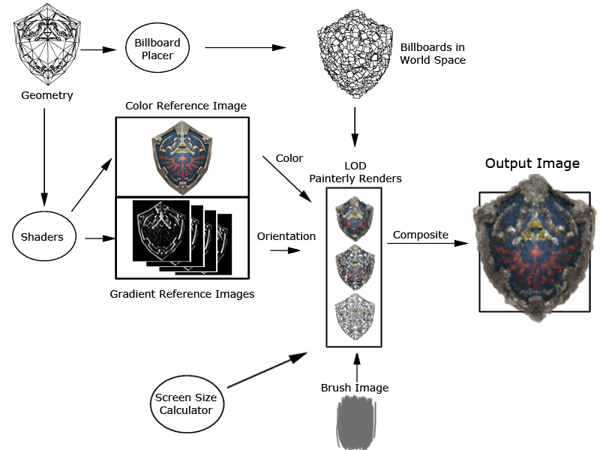
Our Painterly Pipeline

Slide 5
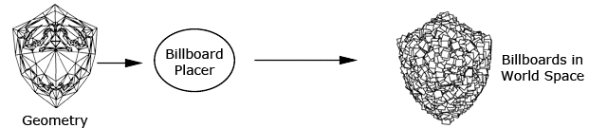
Billboard Placement
Billboards are created independent of the camera over all the mesh objects in the scene
Billboards are instance objects of a single plane object
These billboards texture, color, orientation, and sometimes position are updated each frame

Slide 6
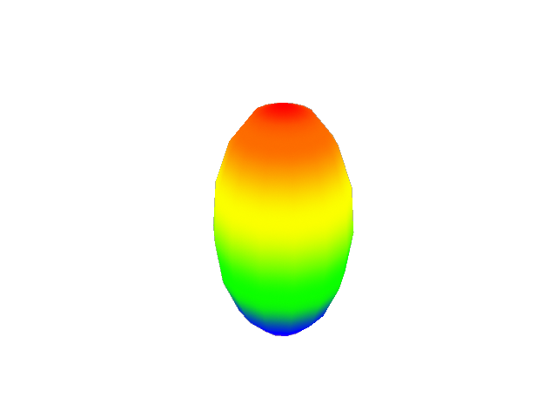
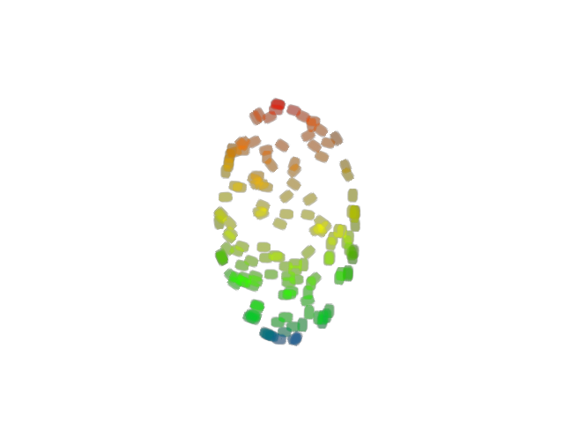
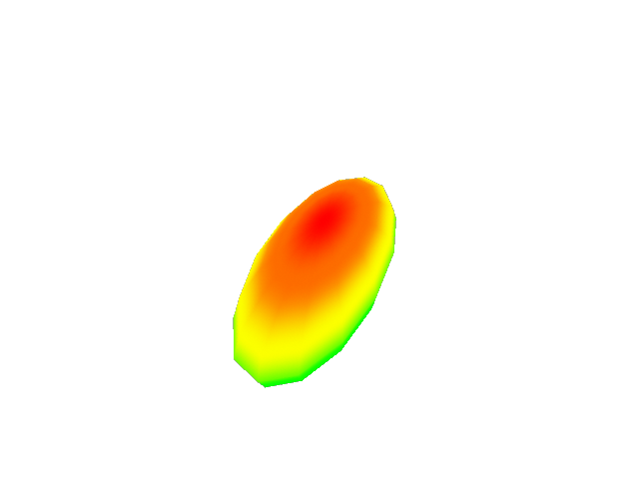
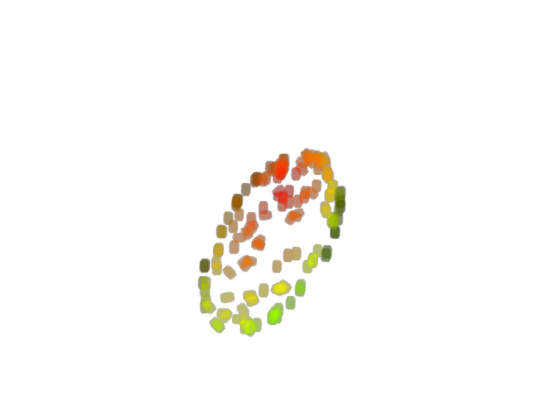
Billboard Placement (cont’d)
Our painterly render defines the billboards position via barycentric coordinates of their parent face.
This allows the billboards to appropriately update their position when the mesh is distorted

Slide 7

Color Reference
For each frame of the animation, a regular render image is blurred, then used as a color lookup for the billboards

Slide 8
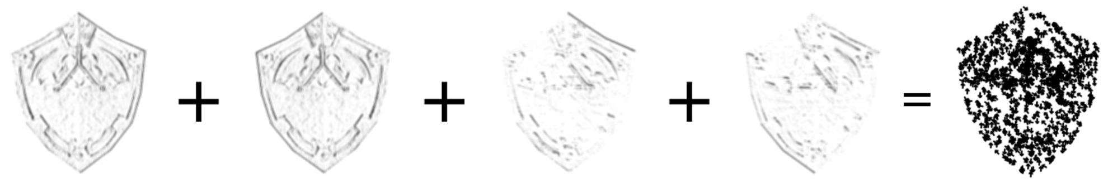
Gradient Images for Orientation
We compute the spatial gradient of a black and white version of the color render and save out 4 reference images: gradient in the positive y, negative y, positive x, and the negative x directions
These images are used as lookups to compute the orientation angle of the brush stroke

Slide 9
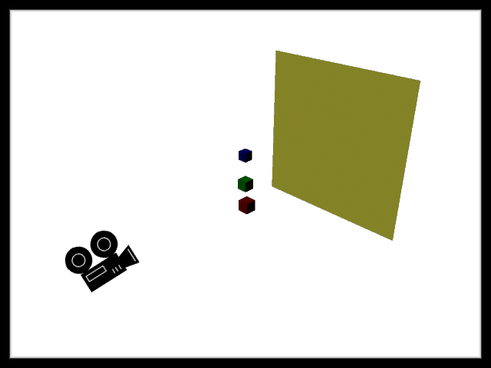
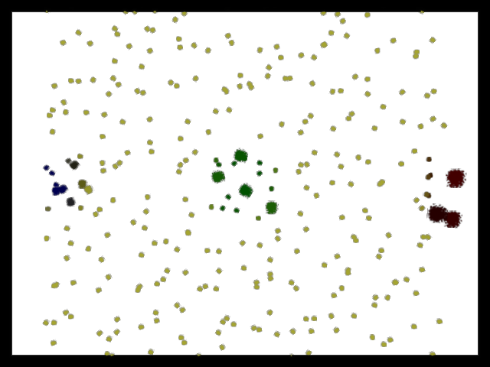
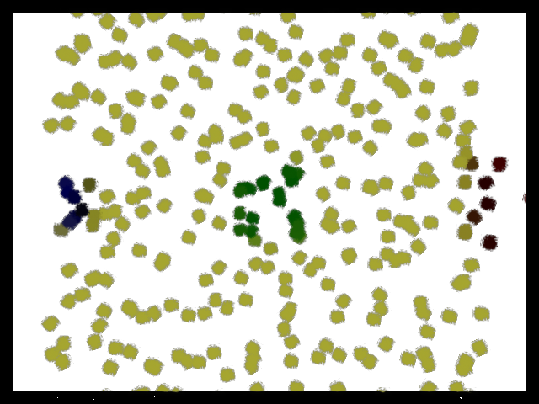
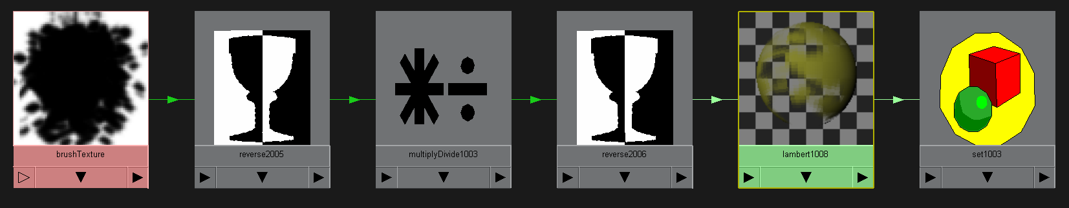
Screen Size Calculation
In order to better emulate painting, we ensure that all brush strokes for a given level of detail have the same apparent size. This is done by scaling all billboards by their distance from the camera.

Slide 10
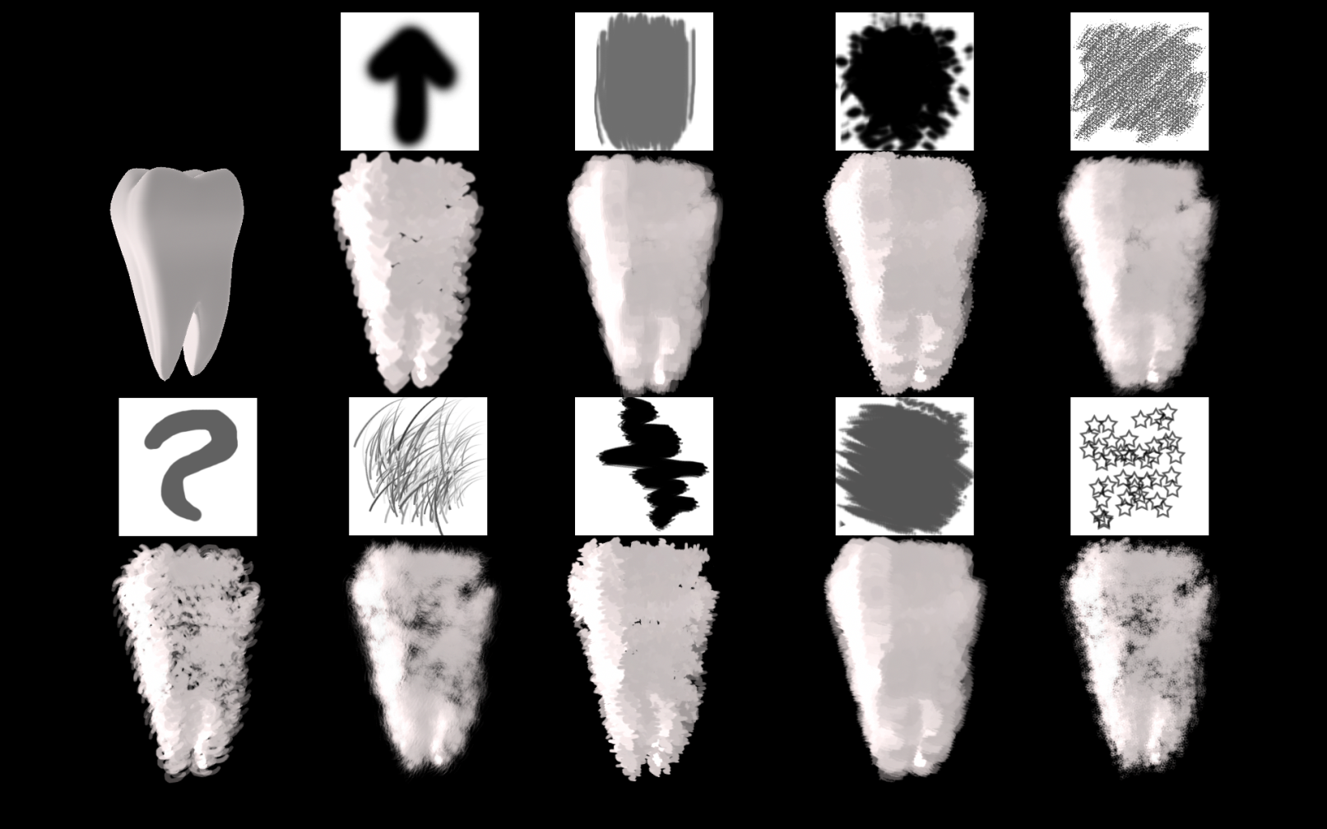
Brush Images
Users are allowed to use any grayscale image as a brush texture. Different textures produce different painting effects.

Slide 11
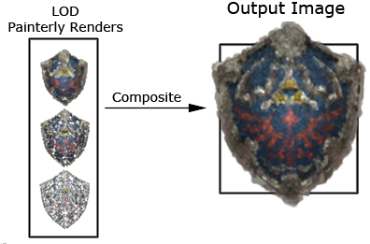
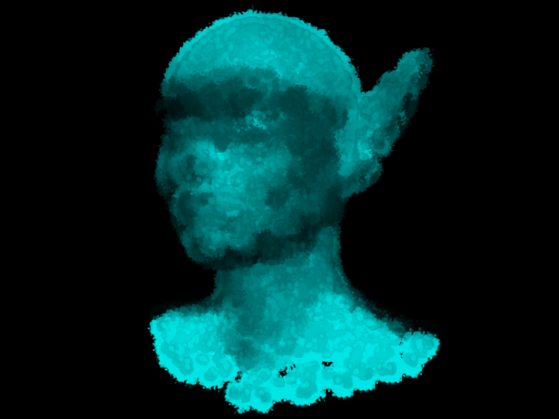
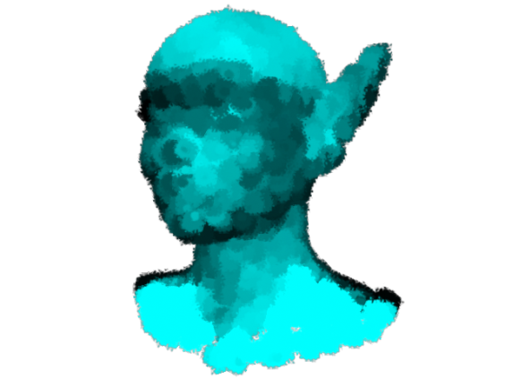
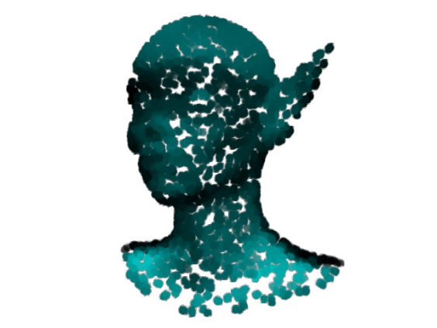
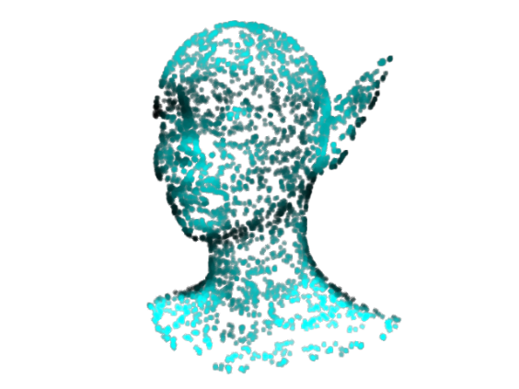
Level of Detail (LOD)
We compute different levels of detail, based on geometry and texture. We layer the different paint strokes on top of each other, much like a painter would set a base color, then refine the details with smaller brush strokes.

Slide 12
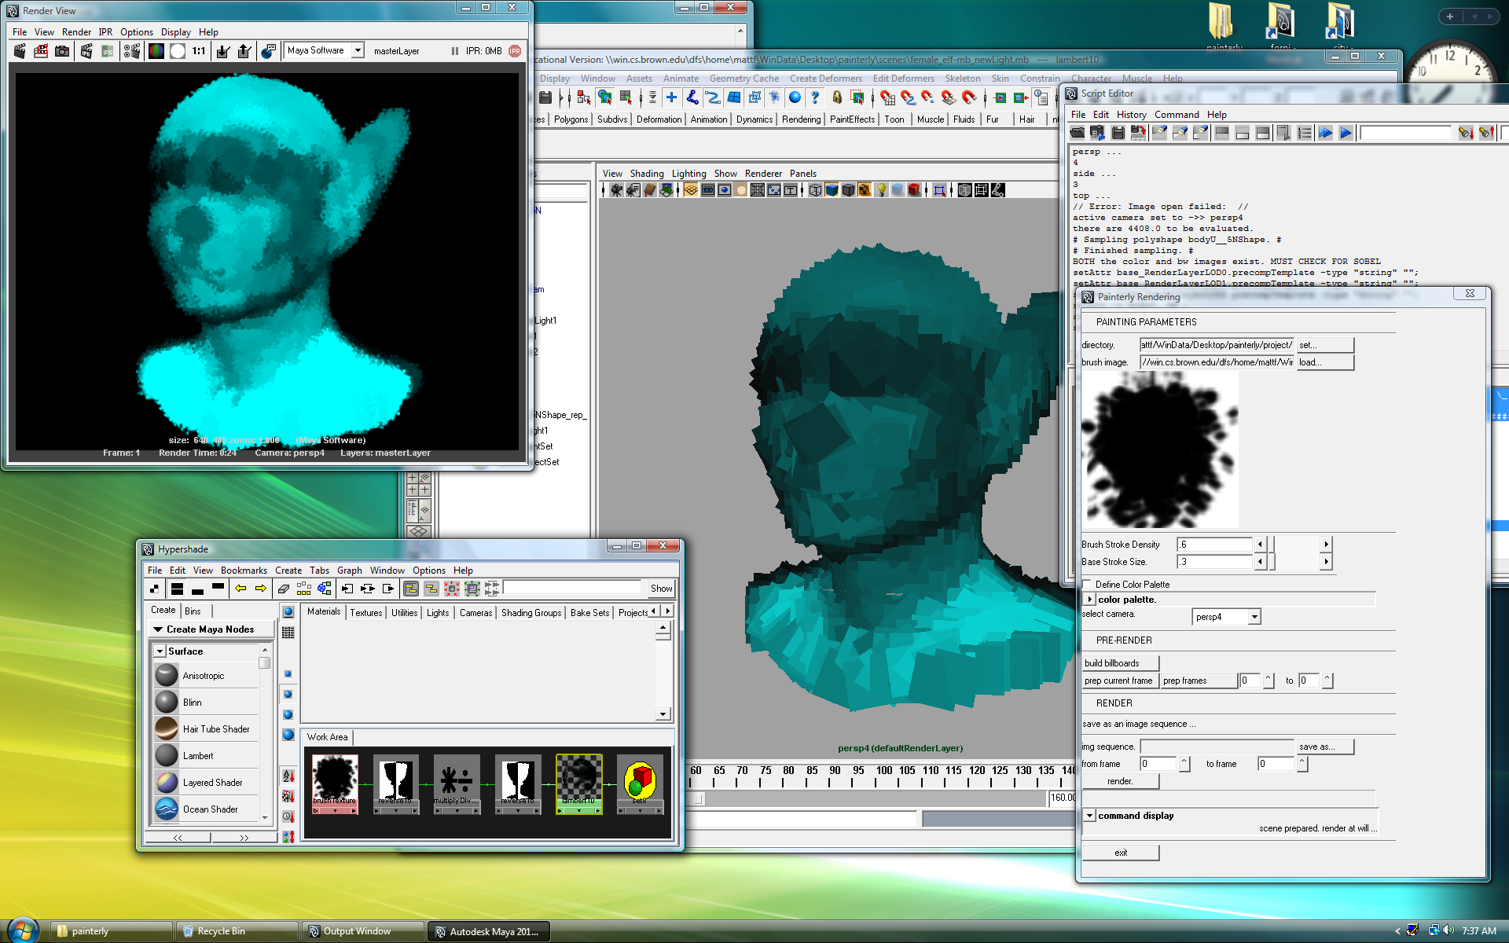
User Interface

Slide 13
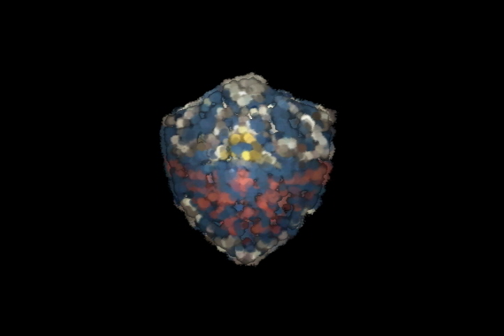
Results

Slide 14
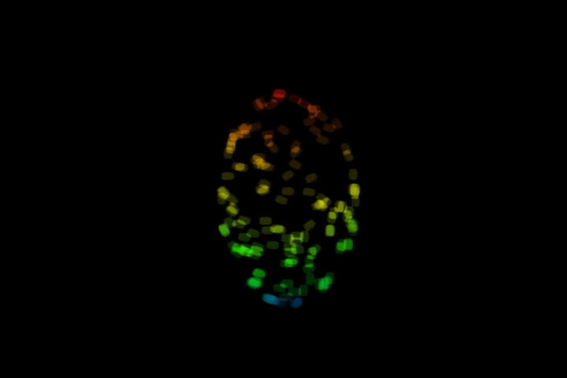

Slide 15


Slide 16
Sources
Billboard Creation
"Realtime Painterly Rendering for Animation",
Daniel Sperl
Billboard Orientation
“Creating Impressionistic Effects from Video and Still Images”,
Brandon Weaver
Level Of Detail
“Art-based Rendering with Continuous Levels of Detail”, Lee
Markosian, Barbara J. Meier, Michael A. Kowalski, Loring S. Holden,
J.D. Northrup, John F. Hughes
“Painterly Rendering with Curved Brush Strokes of Multiple Sizes”,
Aaron Hertzmann
Inspiration
“Painterly Rendering for Animation”,
Barbara J. Meier
"Realtime Painterly Rendering for Animation",
Daniel Sperl

Slide 17
Acknowledgments
Barbara Meier, for the initial paper and extension suggestions
John “Spike” Hughes
Lyn Fong and the rest of the CS224 TA staff

